Slide 1


LIST Store Data Analysis E-commerce Domain

Slide 2
Project analysis slide 4
Project Overview
The Olist Store Data Analysis project focuses on examining e-commerce transactions from the Olist platform, a popular online marketplace. By analyzing a rich dataset of customer orders, we aim to gain valuable insights into purchasing behaviors, payment preferences, delivery times, and overall customer satisfaction. This analysis is crucial for understanding trends and patterns that can drive strategic decisions to enhance the platform's performance and customer experience.

Slide 3
Project analysis slide 4
Project Objectives
Objectives:
Analyze Payment Statistics: Examine how payment methods vary between weekdays and weekends to identify trends and preferences in customer payment behavior.
Evaluate Review Scores and Payment Types: Investigate the relationship between high review scores and payment methods to understand customer satisfaction and payment preferences.
Assess Delivery Times for Pet Shop Orders: Determine the average delivery time for pet shop orders to identify potential areas for improvement in logistics and customer service.
Analyze Customer Spending in São Paulo: Explore spending patterns and payment values of customers from São Paulo to tailor marketing and sales strategies effectively.
Investigate Shipping Days vs. Review Scores: Explore the correlation between shipping duration and review scores to assess the impact of delivery times on customer satisfaction

Slide 4



Project analysis slide 3
Key Performance Indicators (KPI’s)
Weekday vs. Weekend Payment Statistics
Orders with review score 5 & payment type as credit card
Average number of Days taken for delivery to pet shop
Avg price and payment values for São Paulo City
Relationship between shipping days vs. Review scores

Slide 5
Project analysis slide 4
PROJECT METHODOLOGY
DASH BOARDS
LOAD &
USING DIFFERENT
TOOLS
EXTRACT DATA
TRANSFORM
KPI’s
INSIGHTS

Slide 6
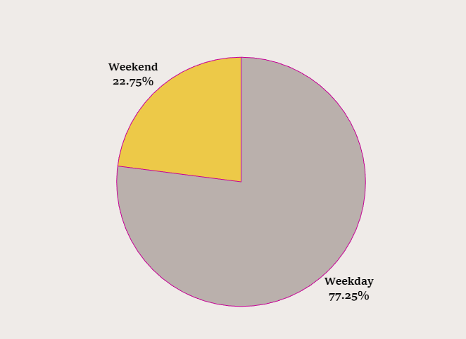
Insights and Suggestions
1) Weekday vs. Weekend Payment Statistics:
This KPI was chosen to analyze payment behaviors based on the day of the week. Understanding whether customers prefer to make purchases on weekdays
or weekends can reveal patterns in consumer activity and help optimize marketing strategies and promotional timing.
Relevance: Insights into payment trends can guide targeted marketing efforts, adjust inventory management, and align promotional campaigns with peak purchasing times,
ultimately enhancing sales performance.
Recommendations:
Marketing Strategies: You might want to focus more promotional efforts during weekdays when customers are more likely to make payments.
Operational Planning: Ensure that your payment processing systems and customer support are fully staffed and optimized for weekdays to handle the higher volume of transactions.
Customer Engagement: Consider running special weekend promotions to boost weekend payment activity and balance out the distribution.

Slide 7
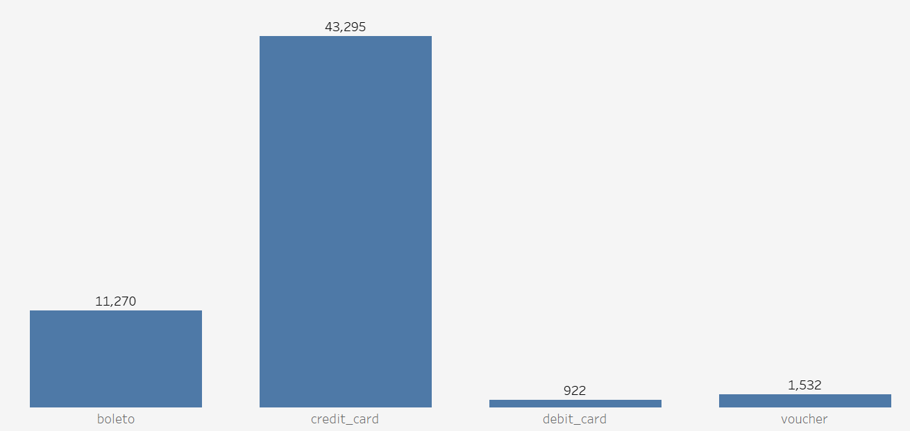
Insights and Suggestions
2) Number of Orders with Review Score 5 and Payment Type as Credit Card:
This KPI focuses on identifying the number of orders that received the highest review score (5) and were paid for using a credit card. It helps to understand
customer satisfaction levels and preferences related to payment methods.
Relevance: High review scores combined with credit card payments indicate a high level of customer satisfaction and preference for a specific payment method.
This information can be used to tailor customer service approaches and payment options to improve overall customer experience.
Recommendations:
Payment Method Optimization: Focus on enhancing the credit card payment experience, as it is the most popular among customers.
Promotional Strategies: Consider offering incentives for using debit cards and vouchers to increase their usage.
Customer Preferences: Understanding why customers prefer certain payment methods can help tailor marketing and operational strategies to meet their needs.

Slide 8
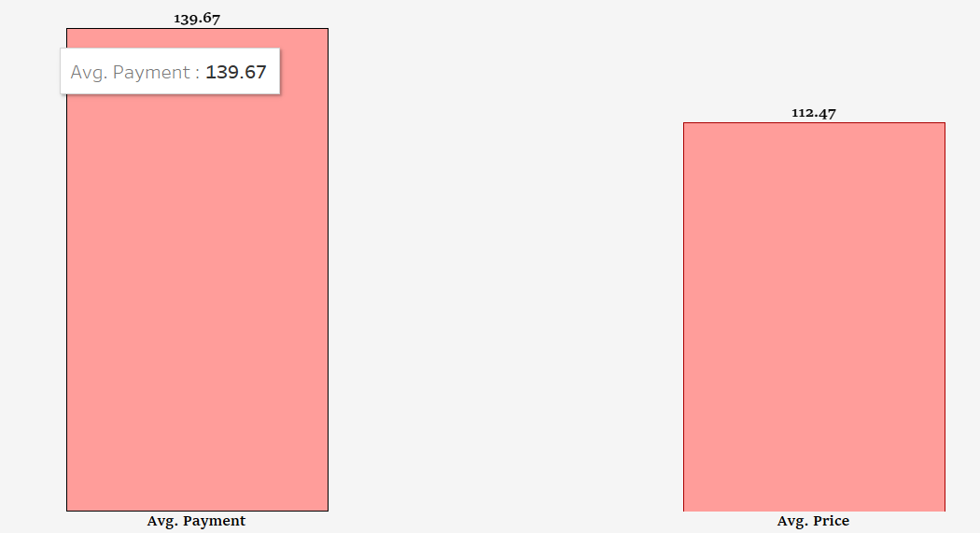
Insights and Suggestions
3)Average Price and Payment Values from Customers of São Paulo City:
This KPI examines the average price of orders and payment values from customers in São Paulo. It helps understand the spending behavior and purchasing power of customers from this key city.
Relevance: Insights into customer spending patterns in São Paulo can inform targeted marketing strategies, pricing adjustments, and promotional offers tailored to this geographic segment, potentially increasing sales and customer engagement.
Potential Impact:
Pricing Strategy: Review your pricing strategy to ensure it aligns with customer expectations and market standards. Consider if the current pricing is sustainable and competitive.
Promotions and Discounts: Analyze the impact of any ongoing promotions or discounts. Ensure they are driving the desired customer behavior and not negatively affecting profitability.
Customer Communication: Clearly communicate the value and pricing of products or services to customers. Transparency can help build trust and justify the prices.

Slide 9
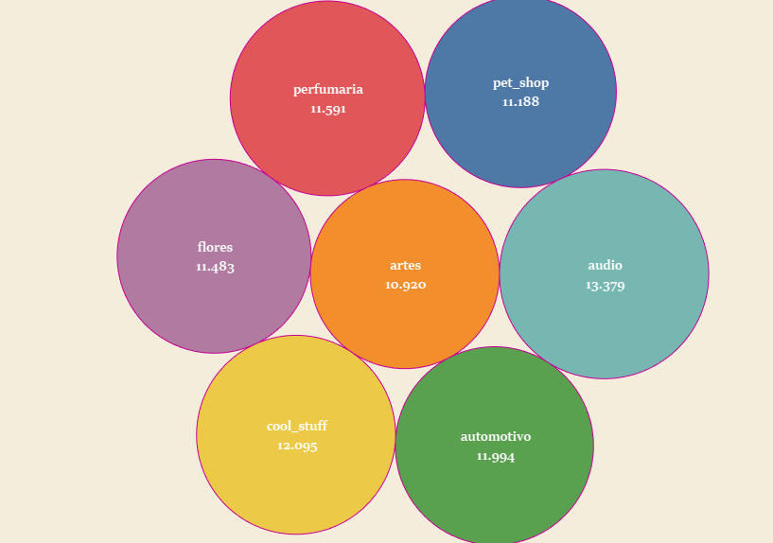
Insights and Suggestions
4) Average Number of Days Taken for Order Delivery (Pet Shop):
This KPI measures the average delivery time for orders specifically from the pet shop category. It provides insights into the efficiency of the delivery process for this product category.
Relevance: Analyzing delivery times for pet shop orders helps identify any delays or inefficiencies in the supply chain. Improving delivery times can enhance customer satisfaction and reduce the likelihood of negative reviews related to shipping delays.
Recommendations:
Process Improvement: Investigate the reasons behind the long delivery times and identify areas for improvement.
Customer Feedback: Gather feedback from customers to understand their expectations and experiences with delivery times.
Competitive Analysis: Compare delivery times with competitors to see if there are industry benchmarks we should aim for.

Slide 10
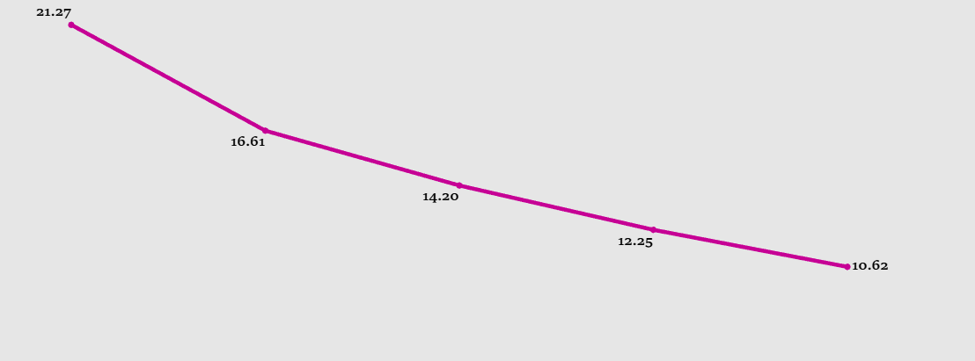
Insights and Suggestions
5) Relationship Between Shipping Days and Review Scores:
This KPI explores the correlation between the number of days taken for shipping and the review scores given by customers.
It aims to assess how shipping times impact customer satisfaction.
Relevance: Understanding this relationship is crucial for improving delivery processes and customer service. Faster shipping times generally lead to higher review scores,
which can enhance the platform’s reputation and customer loyalty.
Recommendations:
Improve Logistics: Streamline your logistics and supply chain processes to reduce delivery times. This could involve optimizing routes, partnering with faster delivery services, or improving inventory management.
Set Realistic Expectations: Clearly communicate expected delivery times to customers and provide regular updates. This can help manage customer expectations and reduce dissatisfaction.
Monitor Performance: Continuously monitor delivery times and review scores to identify trends and areas for improvement. Use this data to make informed decisions about operational changes.

Slide 11

Project analysis slide 4
Dataset Schema

Slide 12
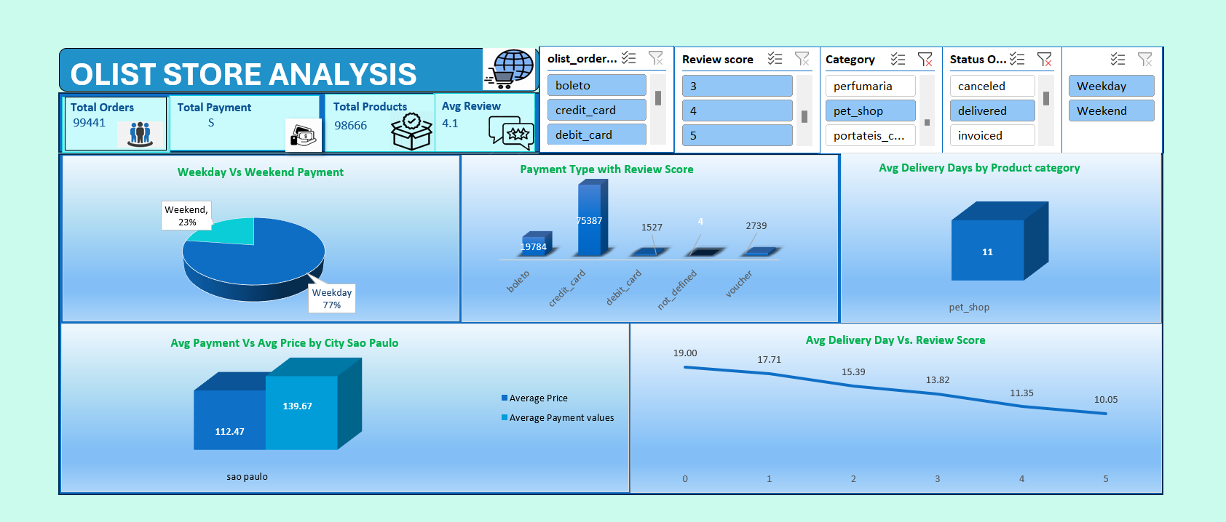
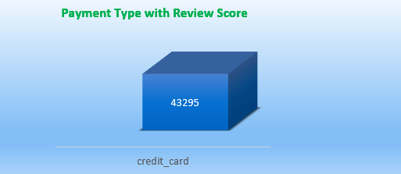
Project analysis slide 11
Excel Dashboard

Slide 13
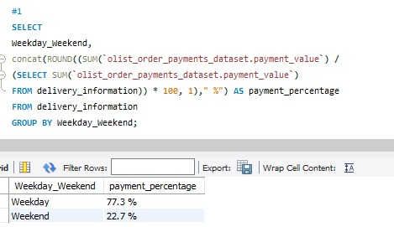
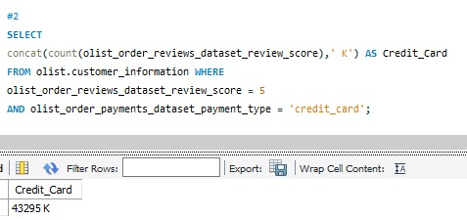
Project analysis slide 10
SQL Queries
1.Weekday Vs. Weekend Payment Statistic
2.Count of Orders with Payment Type Credit Card With Review Score 5

Slide 14
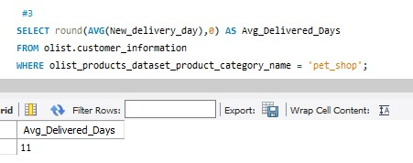
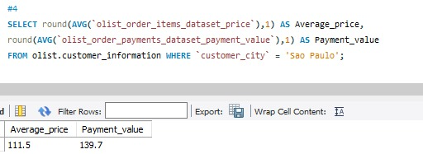
Project analysis slide 10
SQL Queries
3.Avg. Delivery Days for Pet Shops
4.Avg. Price and Avg. Payment Value for Sao Paulo City

Slide 15
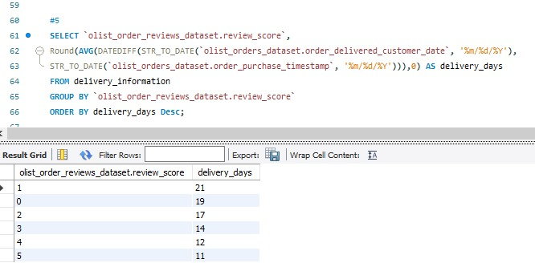
Project analysis slide 10
SQL Queries
5.Relationship Between Avg. Delivery Days & Review Score

Slide 16
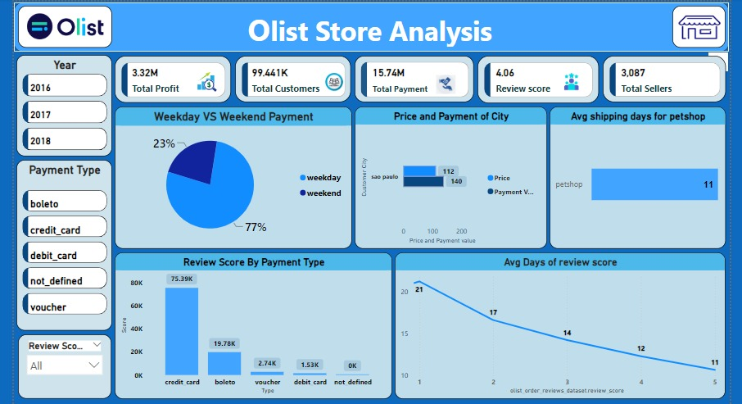
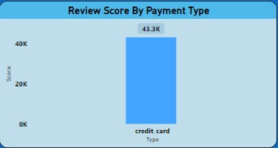
Project analysis slide 11
PowerBI Dashboard

Slide 17
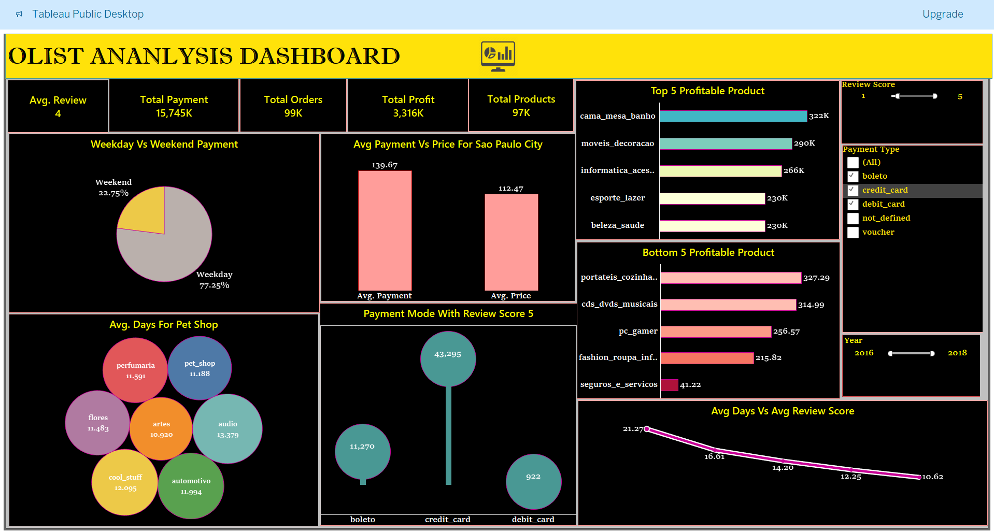
Project analysis slide 11
Tableau Dashboard

Slide 18
Challenges Faced:
Complexity of the Dataset, Cleaning ,Handling large Volume of Data ,Data Importing in MySQL .
Conclusion:
Here are some conclusions from an Olist store analysis project:
Customer satisfaction: Olist has a high level of customer satisfaction, with an average rating of 4 out of 5. The average order cancellation rate is 0.63%, which is a good indicator of high customer satisfaction.
Product categories: The Bed Bath table category is the most ordered product, followed by the Health Beauty category. The Security and Services category is the lowest-rated product category, which suggests it may need improvement.
Payment methods: Credit cards are the most used payment method, followed by Boleto.
Repeat purchases: 2,962 customers made repeat purchases, but only about 6% of those repeat customers accounted for the total sales.
Active sellers: Olist has 96% active sellers, which suggests that the platform is favorable for merchants.

Slide 19
Thank You

